Slide 1
Lukas Wallrich (lukas.wallrich@ stmarys.ac.uk) October 2020 .
PSY4013 – Intro to Social Psychology
1: What is social psychology?

Slide 2
Topics for today
What is social psychology? Why does it matter?
How is social psychological research done?
Intro to the self & social identity
(How does this module work? → Make sure to Zoom into the session at 10.15 am, link on Moodle)

Slide 3
We are “social animals”
Notes:
Picture by David Dennis
Recognized by Aristotle 2,350 years ago
Became more literally true with research into evolution – are very close to animals, small differences must explain a lot

Slide 4
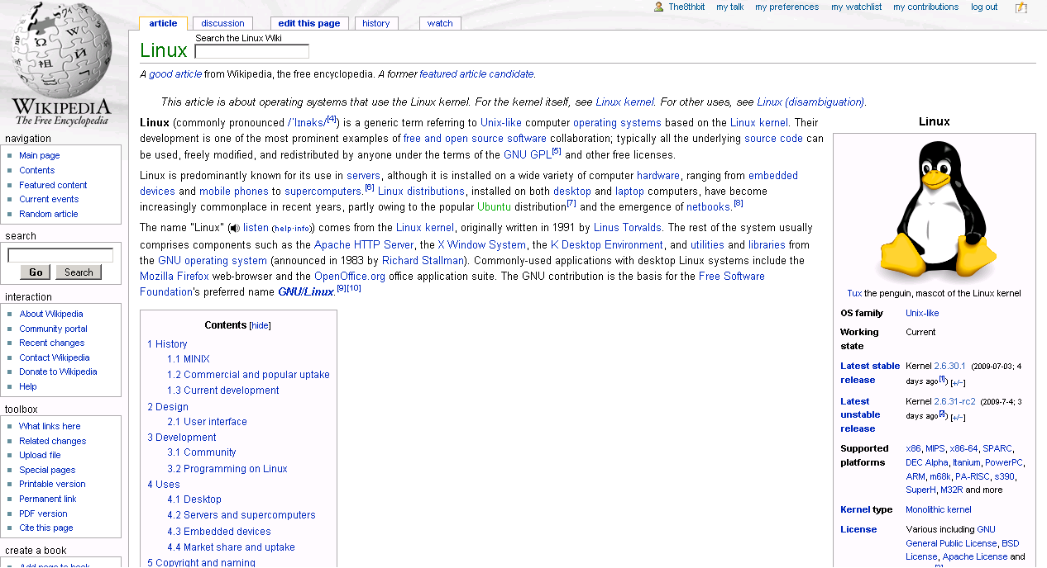
… capable of coordination

Slide 5
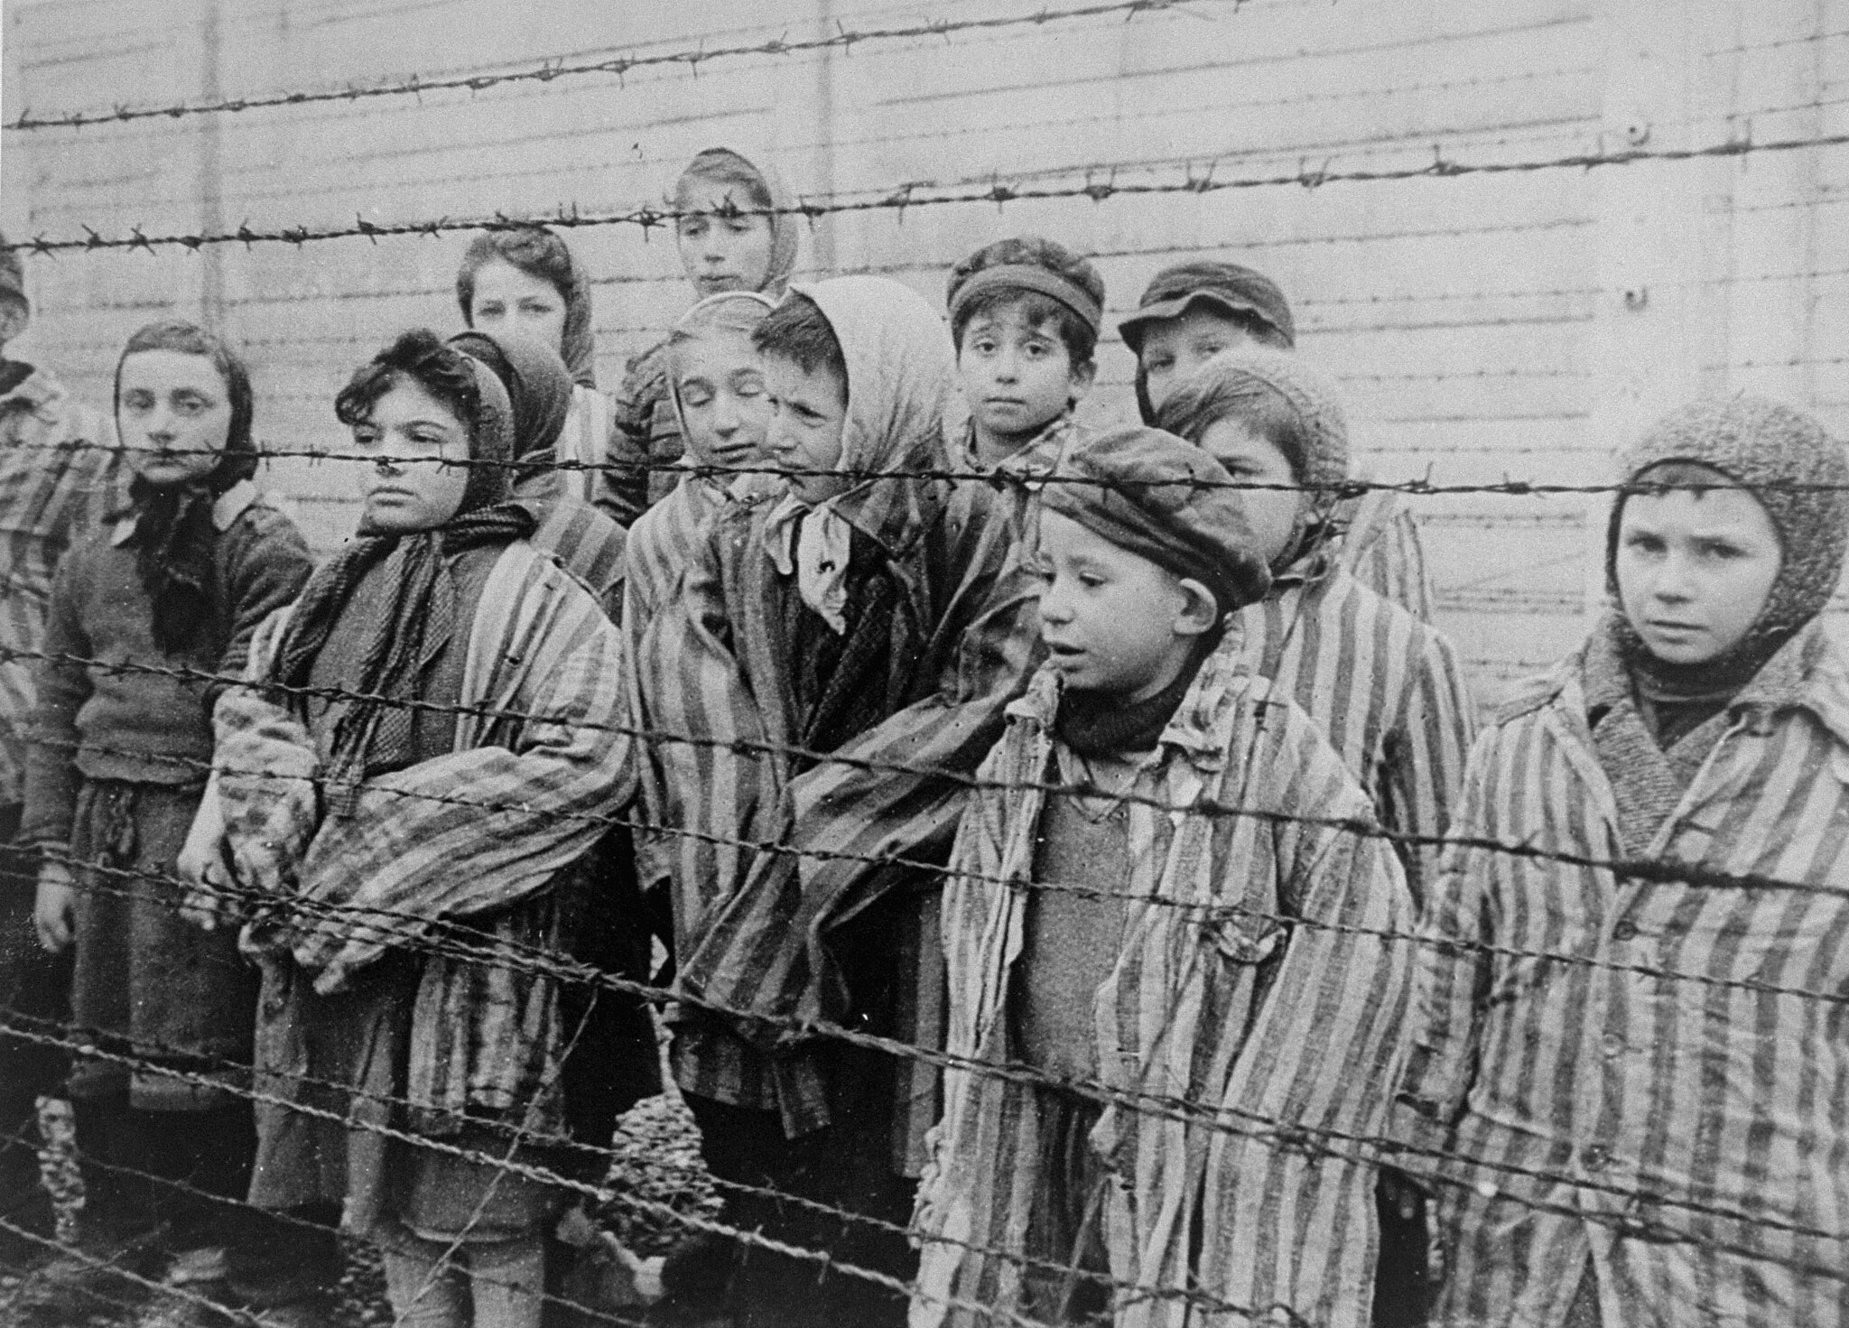
… not always for good
Notes:
Picture by American Holocaust Memorial Museum

Slide 6
… not always at all
Notes:
Litter photo by Bengt Nyman from Vaxholm, Sweden - originally posted to Flickr as IMG_6064-1, CC BY 2.0, https://commons.wikimedia.org/w/index.php?curid=10777224
Frustration photo from Peter Alfred Hess, (https://www.flickr.com/photos/peterhess/2976755407/), CC BY 2.0

Slide 7
Old questions
Hobbes
Rousseau

Slide 8
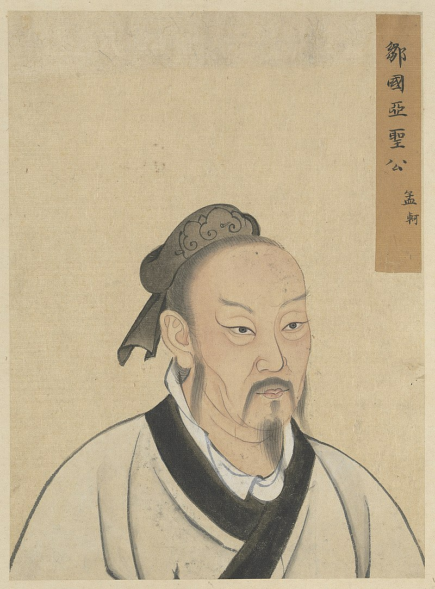
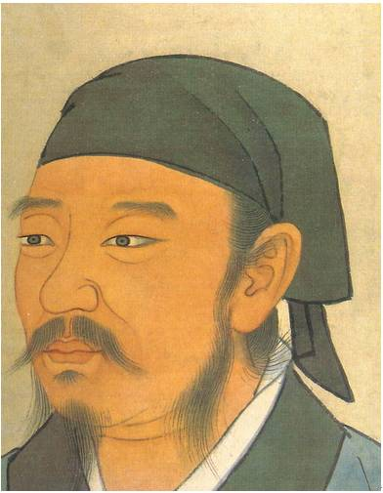
Old questions
Mencius (孟子)
Xunxi (荀況)
Notes:
Same time as Aristotle
https://www.utm.edu/staff/jfieser/class/110/4-eastern.htm
Mencius: natural tendency for goodness, starting from commiseration, shame, respect and approval
Xunxi: “love of gain” is driving force from very start – and leads to bad

Slide 9
Uncertain answers
Science done right never reveals ‘the truth’ – instead, allows us to reduce uncertainty, exclude possibilities and build reasonable theories
Science is not always done right (or read correctly) – replication crisis
Leap from observation to interpretation – e.g., placebo effects

Slide 10
With strong relevance
Need to shape institutions, educate individuals, decide how to deal with each other
More complex than natural sciences, because beliefs matter:
Self-fulfilling prophecies
Placebos and nocebos
Selective perception, and reinforcing cycles

Slide 11
Topics for today
What is social psychology? Why does it matter?
How is social psychological research done?
Intro to the self & social identity

Slide 12
What is social psychology?
“The scientific investigation of how the thoughts, feelings and behaviours of individuals are influenced by the actual, imagined, or implied presence of others”
Gordon Allport (1935)
Put simply:
Explore how people are affected by other people
Using scientific methods

Slide 13
Topics for today
What is social psychology? Why does it matter?
How is social psychological research done?
Intro to the self & social identity

Slide 14
A scientific question
What travels faster through space?
Sound?
Light?
Are you 100% sure of your answer?
How do you know?

Slide 15
Another scientific question
Are women given the same opportunities as men at work?
Yes?
No?
Are you 100% sure of your answer?
How do you know?

Slide 16
People are not inanimate objects
Some of the ways people differ from inanimate objects …
They have their own opinions
They are social beings
They prefer to think positively of themselves
They want to be liked by researchers
They are capable of deceit
They are uncomfortable about certain topics
They can be harmed

Slide 17
The social world is not the physical world
(Much faster) change over time
Much harder to know how far to generalize
Less deterministic (at a visible scale) ... we call it free will

Slide 18
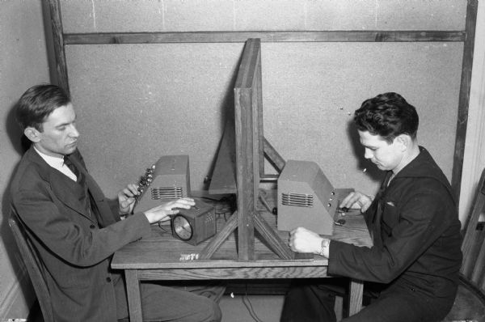
Researching the social world: Experimental methods
Laboratory experiments
Field experiments
Notes:
Baron & Branscombe (2014); Hogg & Vaughan (2011)
Experiments: require randomisation across different conditions!

Slide 19
Researching the social world: Experimental methods
Laboratory experiments
Experiments in an artificial setting
+ High level of control
‐ Artificial, demand characteristics
Field experiments
Experiments in a natural setting
+ “Ecologically valid”
‐ Lower level of control (“internal validity”)
Notes:
Baron & Branscombe (2014); Hogg & Vaughan (2011)
Experiments: require randomisation across different conditions!

Slide 20
Researching the social world: Correlational research … most frequently: survey research
Interviews or questionnaires that ask participants about a number of carefully chosen topics
+ Good for obtaining large amounts of data, good generalisability
‐ Experimenter bias, evaluation apprehension, subject bias, no evidence for causation
Notes:
Baron & Branscombe (2014); Hogg & Vaughan (2011)

Slide 21
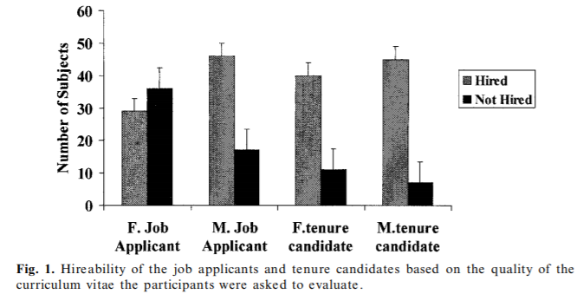
The question again: are women given the same opportunities as men at work?
238 psychology academics in US universities were provided with a CV and asked whether they would hire the applicant (Steinpreis, Anders & Ritzke, 1999)
Notes:
Steinpreis, Anders, & Ritzke (1999)

Slide 22
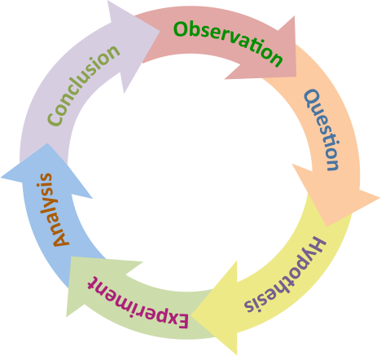
Use of the scientific method

Slide 23
Where things go wrong
Selective publishing (and reading) – unsuccessful experiments go unnoticed
Misunderstanding probabilistic conclusions – the cycle needs to continue, evidence be considered together
Doing several steps at once – data mining. Cannot test hypothesis on the data that gave rise to it, need to look for new data

Slide 24
Topics for today
What is social psychology? Why does it matter?
How is social psychological research done?
Intro to the self & social identity

Slide 25
One self?
Properly speaking, a man has as many social selves as there are individuals who recognize him and carry an image of him in their head.
William James
But the concept of the self loses its meaning if a person has multiple selves…the essence of self involves integration of diverse experiences into a unity…In short, unity is one of the defining features of selfhood and identity.
Roy Baumeister
Notes:
William James: founder of American psychology & one of the first to think about split self (material self, social self, spiritual self) + pure ego (the ongoing stream of consciousness that provides continuity – linked to what is now studied as autobiographical memory)
Roy Baumeister – current leading social psychologist: done much research on self-esteem and self-control

Slide 26
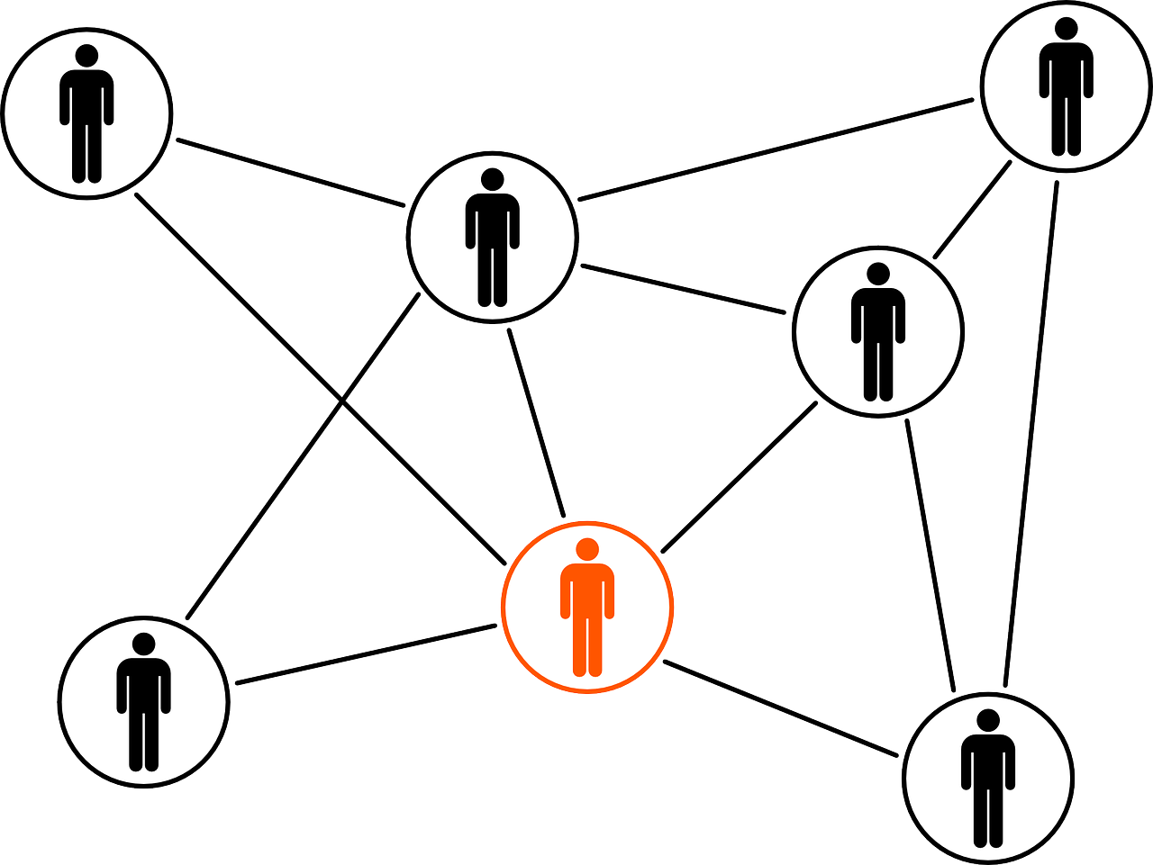
The social emergence of the selves
Symbolic interactionism (Mead)
Social comparisons (Festinger)
Self-categorisation (Turner)
Social Identity Theory (Tajfel & Turner)

Slide 27
Symbolic Interactionism
Meaning and identity is created through interaction, it is not inherent in words or categories
Interaction takes place through use of symbols that acquire meaning in interaction
Implies that understanding of self shaped by sense of how one is seen by others
Mead (1934)

Slide 28
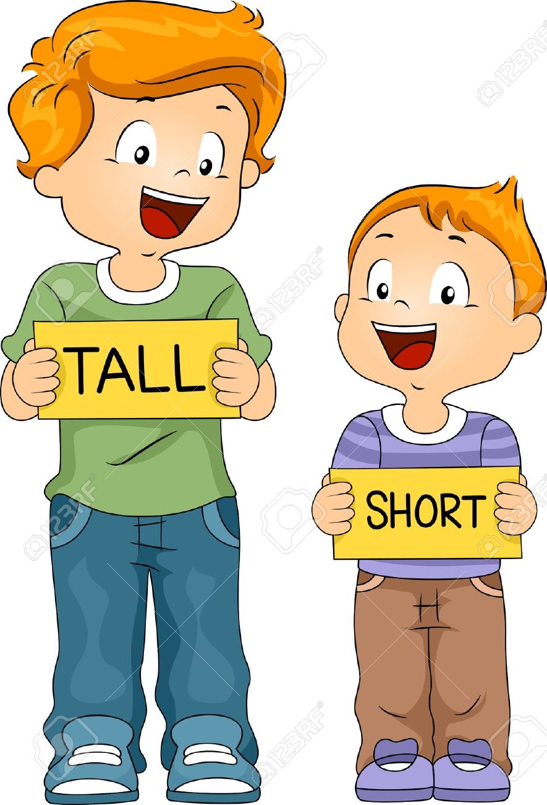
Social comparisons

Slide 29
Social comparisons
Leon Festinger (1954)
Taylor & Lobel (1989)
Notes:
Upward: can lead to feelings of inferiority, to FOMO etc.
In general: comparisons allow for learning. How do I know whether I am intelligent, athletic, polite, generous without comparisons?

Slide 30
Self-categorization theory
Human
Social (Group)
Personal
(Turner et al., 1989)
Notes:
Cognitive process to make sense of ourselves and others at different levels
Multiple identities at different levels – see others at that higher level

Slide 31
Student
St Mary’s student
St Mary’s psych. student
Inclusive
Moderately
Inclusive
Less Inclusive
Notes:
Network of identities –
Motivational role: try to balance belonging and distinctiveness

Slide 32
Sports Fan
Football Fan
Arsenal Fan
Inclusive
Moderately
Inclusive
Less Inclusive
Notes:
Network of identities –
Motivational role: try to balance belonging and distinctiveness

Slide 33
Group membership and helping
Levine et al. (2005)
Got Arsenal fans to affirm their Arsenal fan identity
Sent them past ‘injured’ Arsenal fan, 92% helped
Or ‘injured’ Liverpool fan, 30% helped

Slide 34
Group membership and helping
Levine et al. (2005)
Got Arsenal fans to affirm their football fan identity
Sent them past ‘injured’ Arsenal fan, 80% helped
Or ‘injured’ Liverpool fan, 70% helped

Slide 35
Some take-aways from today
Social psychology studies how people influence and engage with each other – creates knowledge that can shape the world (and our lives)
The scientific method is at the heart of (experimental) social psychology – there can be alternative approaches, but we can’t be sloppy.
“No man is an island” – identity is inherently social. That can lead to good and bad outcomes – focus for next week.

