Slide 1
Lukas Wallrich (lukas.wallrich@ stmarys.ac.uk) October 2020 .
PSY4013 – Intro to Social Psychology
2: Prejudice and intergroup relations
A: Emergence of prejudice
Notes:
Lecture split into multiple parts, with small review questions in between – this first part is the heaviest

Slide 2
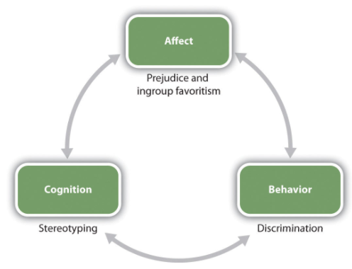

Slide 3
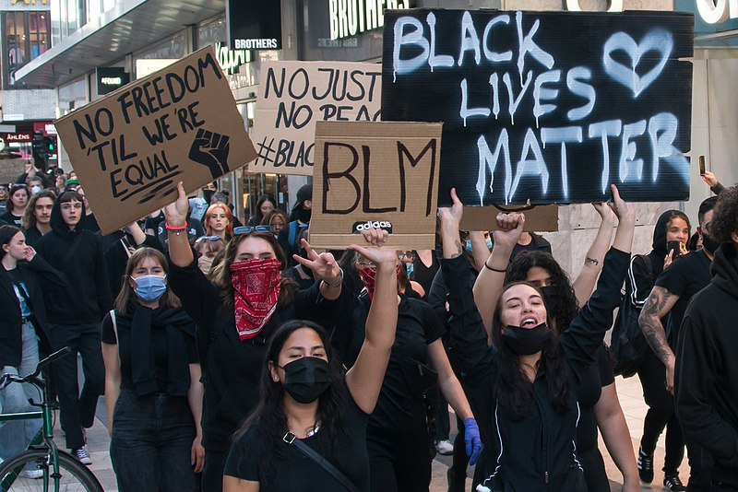

Slide 4
Defining “Prejudice”
“An unjustifiable (negative) attitude toward a group and its individual members.”
(Myers, 2003, p. 715)
“(Unfavourable) attitude towards a social group and its members.”
(Hogg & Vaughan, 2002, p. 342)
Prejudice means “prejudgement” – so expected to shape or replace specific judgements

Slide 5
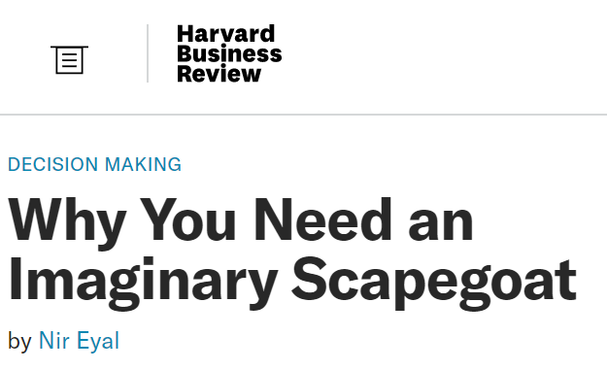
Prejudice: Emotional Sources
Scapegoat Theory
When people are angry and upset, they can displace their (negative) feelings onto groups that are disliked, visible, and relatively powerless.

Slide 6
Prejudice: Cognitive Sources
Categorisation:
Outgroup Homogeneity: The perception that members of the outgroup are more similar to each other than they really are.
Essentialism
Entativity
Remember self-categorization theory?
Notes:
See ourselves as the sum of all the identities – while outgroups are defined as just one identity – so that’s just how “the Mexicans” are
Entativity: seeing outgroups as entities rather than collections of individuals

Slide 7
Prejudice: Cognitive Sources
Flawed availability heuristic: Judge probability by availability
(terrorist vs bathtub deaths)
Distinctive Events
Distinctive People
Illusory Correlations: Tendency to see relationships, or correlations, between events that are actually unrelated
Minorities & negative behaviours
Notes:
Google terrorist vs bathtub deaths – fascinating debate whether that is a helpful comparison – but it is true
For example, Christian mass shooters and Muslim mass shooters – religions is only reported and noticed in one case.
(White people usually don’t ask: what’s wrong with White people?)

Slide 8
Prejudice: Cognitive Sources
System Justification Theory & Just World Hypothesis
Psychological need to live in fair world
Arrangements that appear unfair unless there are group-based differences
Thus, belief in group-based differences

Slide 9
Prejudice: Social Sources
Social Inequalities (and System Justification)
Ingroup ↔ Outgroup
Unequal status
Conformity
Gaining acceptance by the group
Group polarisation
Institutional Support
Curricula
Media/culture
Law / labour market etc.

Slide 10
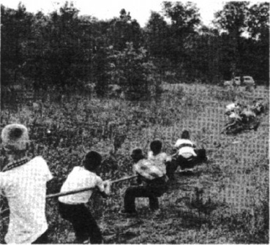
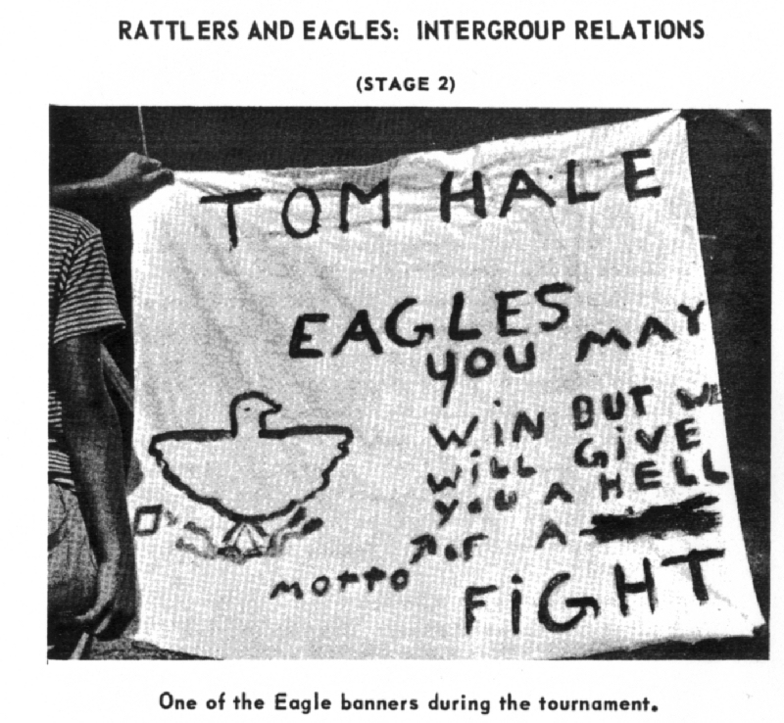
Origins of intergroup prejudice: Realistic conflict
Sherif & Sherif’s 1959 summer camp study
Boys placed into groups, started competitions
Negative views and aggression escalated outside organised activities
Notes:
Read the book chapter – very problematic study, still makes sense that competition can lead to negative emotions towards competitors

Slide 11
Another take: Social Identity Theory (Tajfel & Turner, 1979)
Human need for positive social identity → positive view of ingroups & ingroup distinctiveness
also true for low-status ingroups, which protects against low self-esteem
By comparison, negative view of outgroups → “ingroup love or outgroup hate?”
Social categorisation may be enough to produce prejudice (Rabbie & Horowitz, 1969)
Probably only when there is uncertainty, so that categorization matters (Grieve & Hogg, 1999)
Notes:
Open question: which identities become relevant?
Salience of different aspects – if you talk to your classmates about identity, you will rarely notice that you meet other students.
Dominant categories become universalised – when asked about their identity, white men mention these categories less than women of colour.

Slide 12
Lukas Wallrich (lukas.wallrich@ stmarys.ac.uk) October 2020 .
PSY4013 – Intro to Social Psychology
2: Prejudice and intergroup relations
B: Maintaining false beliefs
Notes:
Lecture split into multiple parts, with small review questions in between – this first part is the heaviest

Slide 13
Leon Festinger’s studies on cognitive dissonance (1956)

Slide 14
Leon Festinger’s studies on cognitive dissonance (1956)
Undeniable disconfirmation can strengthen belief if
There is deep conviction
There is social support
There has been costly commitment to the belief

Slide 15
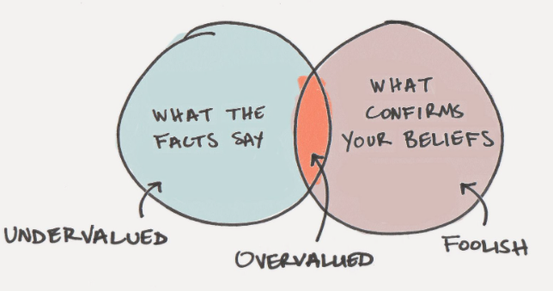
Confirmation bias / motivated reasoning
Tendency to seek information that confirms beliefs – not that which informs
Source: jamesclear.com

Slide 16
Confirmation bias / motivated reasoning
Tendency to seek information that confirms beliefs – not that which informs
Weak distinction between facts and emotive claims – observe extreme gaps between estimates and statistics (e.g., crime, immigration)
Motivated reasoning: skilled at using evidence to support beliefs, especially if social bonds are at stake

Slide 17
Two cautionary reads
Notes:
https://www.ipsos.com/sites/default/files/ct/news/documents/2018-12/ipsos-mori-perils-of-perception-2018.pdf

Slide 18
Lukas Wallrich (lukas.wallrich@ stmarys.ac.uk) October 2020 .
PSY4013 – Intro to Social Psychology
2: Prejudice and intergroup relations
C: Impact of prejudice and stereotypes
Notes:
Lecture split into multiple parts, with small review questions in between – this first part is the heaviest

Slide 19
Self-fulfilling Prophecies (Rosenthal & Jacobson, 1968)
Notes:
How do teachers actually decide who the bloomers are?

Slide 20
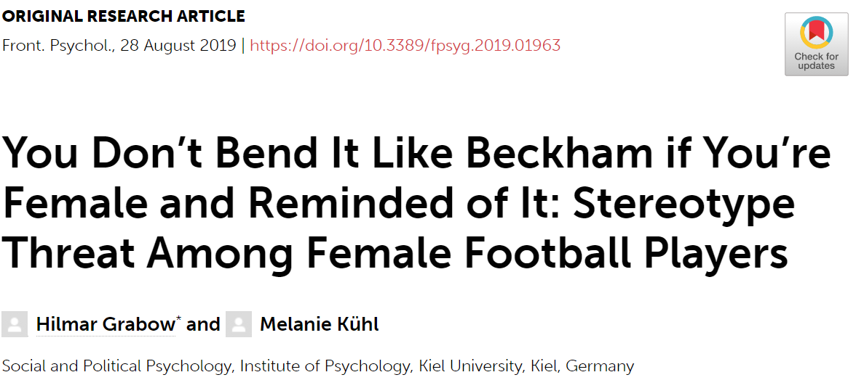
Stereotype threat

Slide 21
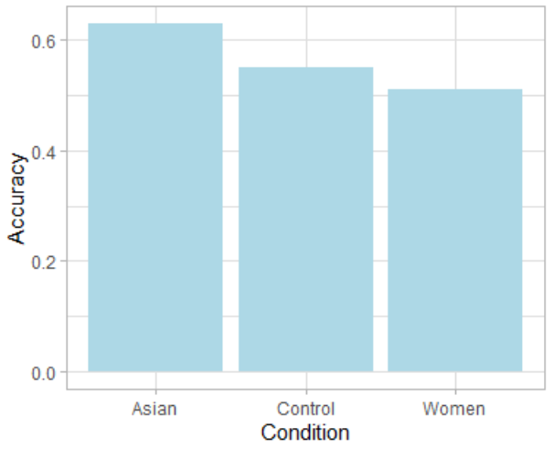
Stereotype lift? – Singh et al. (1999)
Study with East Asian women participants
Made aware of either Asian or female identity, then given a maths test
Beware: effect does not replicate consistently!
Notes:
Participants who did not know stereotypes were excluded
First studied by Singh et al. (1999), here data taken from replication by Gibson, Losee and Vitiello (2014)
So apart from stereotype threat there might also be stereotype lift – but there is disagreement about the strength of the evidence – see https://replicationindex.com/2019/01/02/social-psychology-textbook-audit-stereotype-threat/

Slide 22
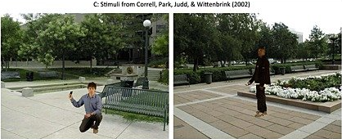
Implicit associations and behaviour
Live in a culture where Black ~~ dangerous
Association learned at implicit level – test yourself at https://implicit.harvard.edu* (for weapons, need to select US resident)
Might lead to faster decision to shoot Black suspects (at least in student samples tested on video games, most police perform better)

Slide 23
Prejudice: Impact
Self-fulfilling Prophecy
Any expectation about what another person is like, influences how we act toward that person, which causes that person to behave in a way consistent with our original expectation(s)
Stereotype Threat
Apprehension experienced by members of a minority group that their behaviour might confirm a negative stereotype – if they care about disconfirming it.
Also: avoidance, discrimination, etc.

Slide 24
Lukas Wallrich (lukas.wallrich@ stmarys.ac.uk) October 2020 .
PSY4013 – Intro to Social Psychology
2: Prejudice and intergroup relations
D: What to do about prejudice?
Notes:
Lecture split into multiple parts, with small review questions in between – this first part is the heaviest

Slide 25
Contact Hypothesis (Allport, 1954)
Bringing members of opposing social groups together will improve intergroup relations and reduce prejudice and discrimination, if the groups have:
equal status in the interaction,
a cooperative working style,
common goals,
support by authorities for such contact

Slide 26
Contact generally works
Meta-analysis (Tropp & Pettigrew, 2006) suggests that conditions are helpful but not necessary – 94% of all contact studies found negative relationship between contact and prejudice
Even sub-optimal contact works
Many mediators (pathways). Empathy and anxiety most important
Risk: sub-typing, i.e. making an exception for those who don’t fit the stereotype.

Slide 27
Different ways of promoting attitude change
Demand colour-blindness and the suppression of stereotypes – does not work; makes contact unpleasant, and retains bias (e.g., Galinsky & Moskowitz, 2000)
Have authorities promote multiculturalism (might backfire, e.g., increase support for Trump, Osborn, Sosa & Rios, 2019)
Emphasise that majority holds pro-diversity attitudes and engages in positive behaviours – improves attitudes and feeling of inclusion (Murrar, Campbell & Brauer, 2020) – related: extended intergroup contact

Slide 28
Quick summary
Sources of prejudice and stereotypes
Realistic conflict
Social identity (positive distinctiveness)
Cognitive processes (illusory correlations)
Social influence & institutions
Maintenance of false beliefs
Cognitive dissonance & motivated reasoning
Group dynamics (next week)
Impact of prejudice
Self-fulfilling prophecies
Stereotype threat & lift
Implicit bias shaping behaviour
Addressing prejudice
Intergroup contact
Emphasizing positive social norms

