Slide 1
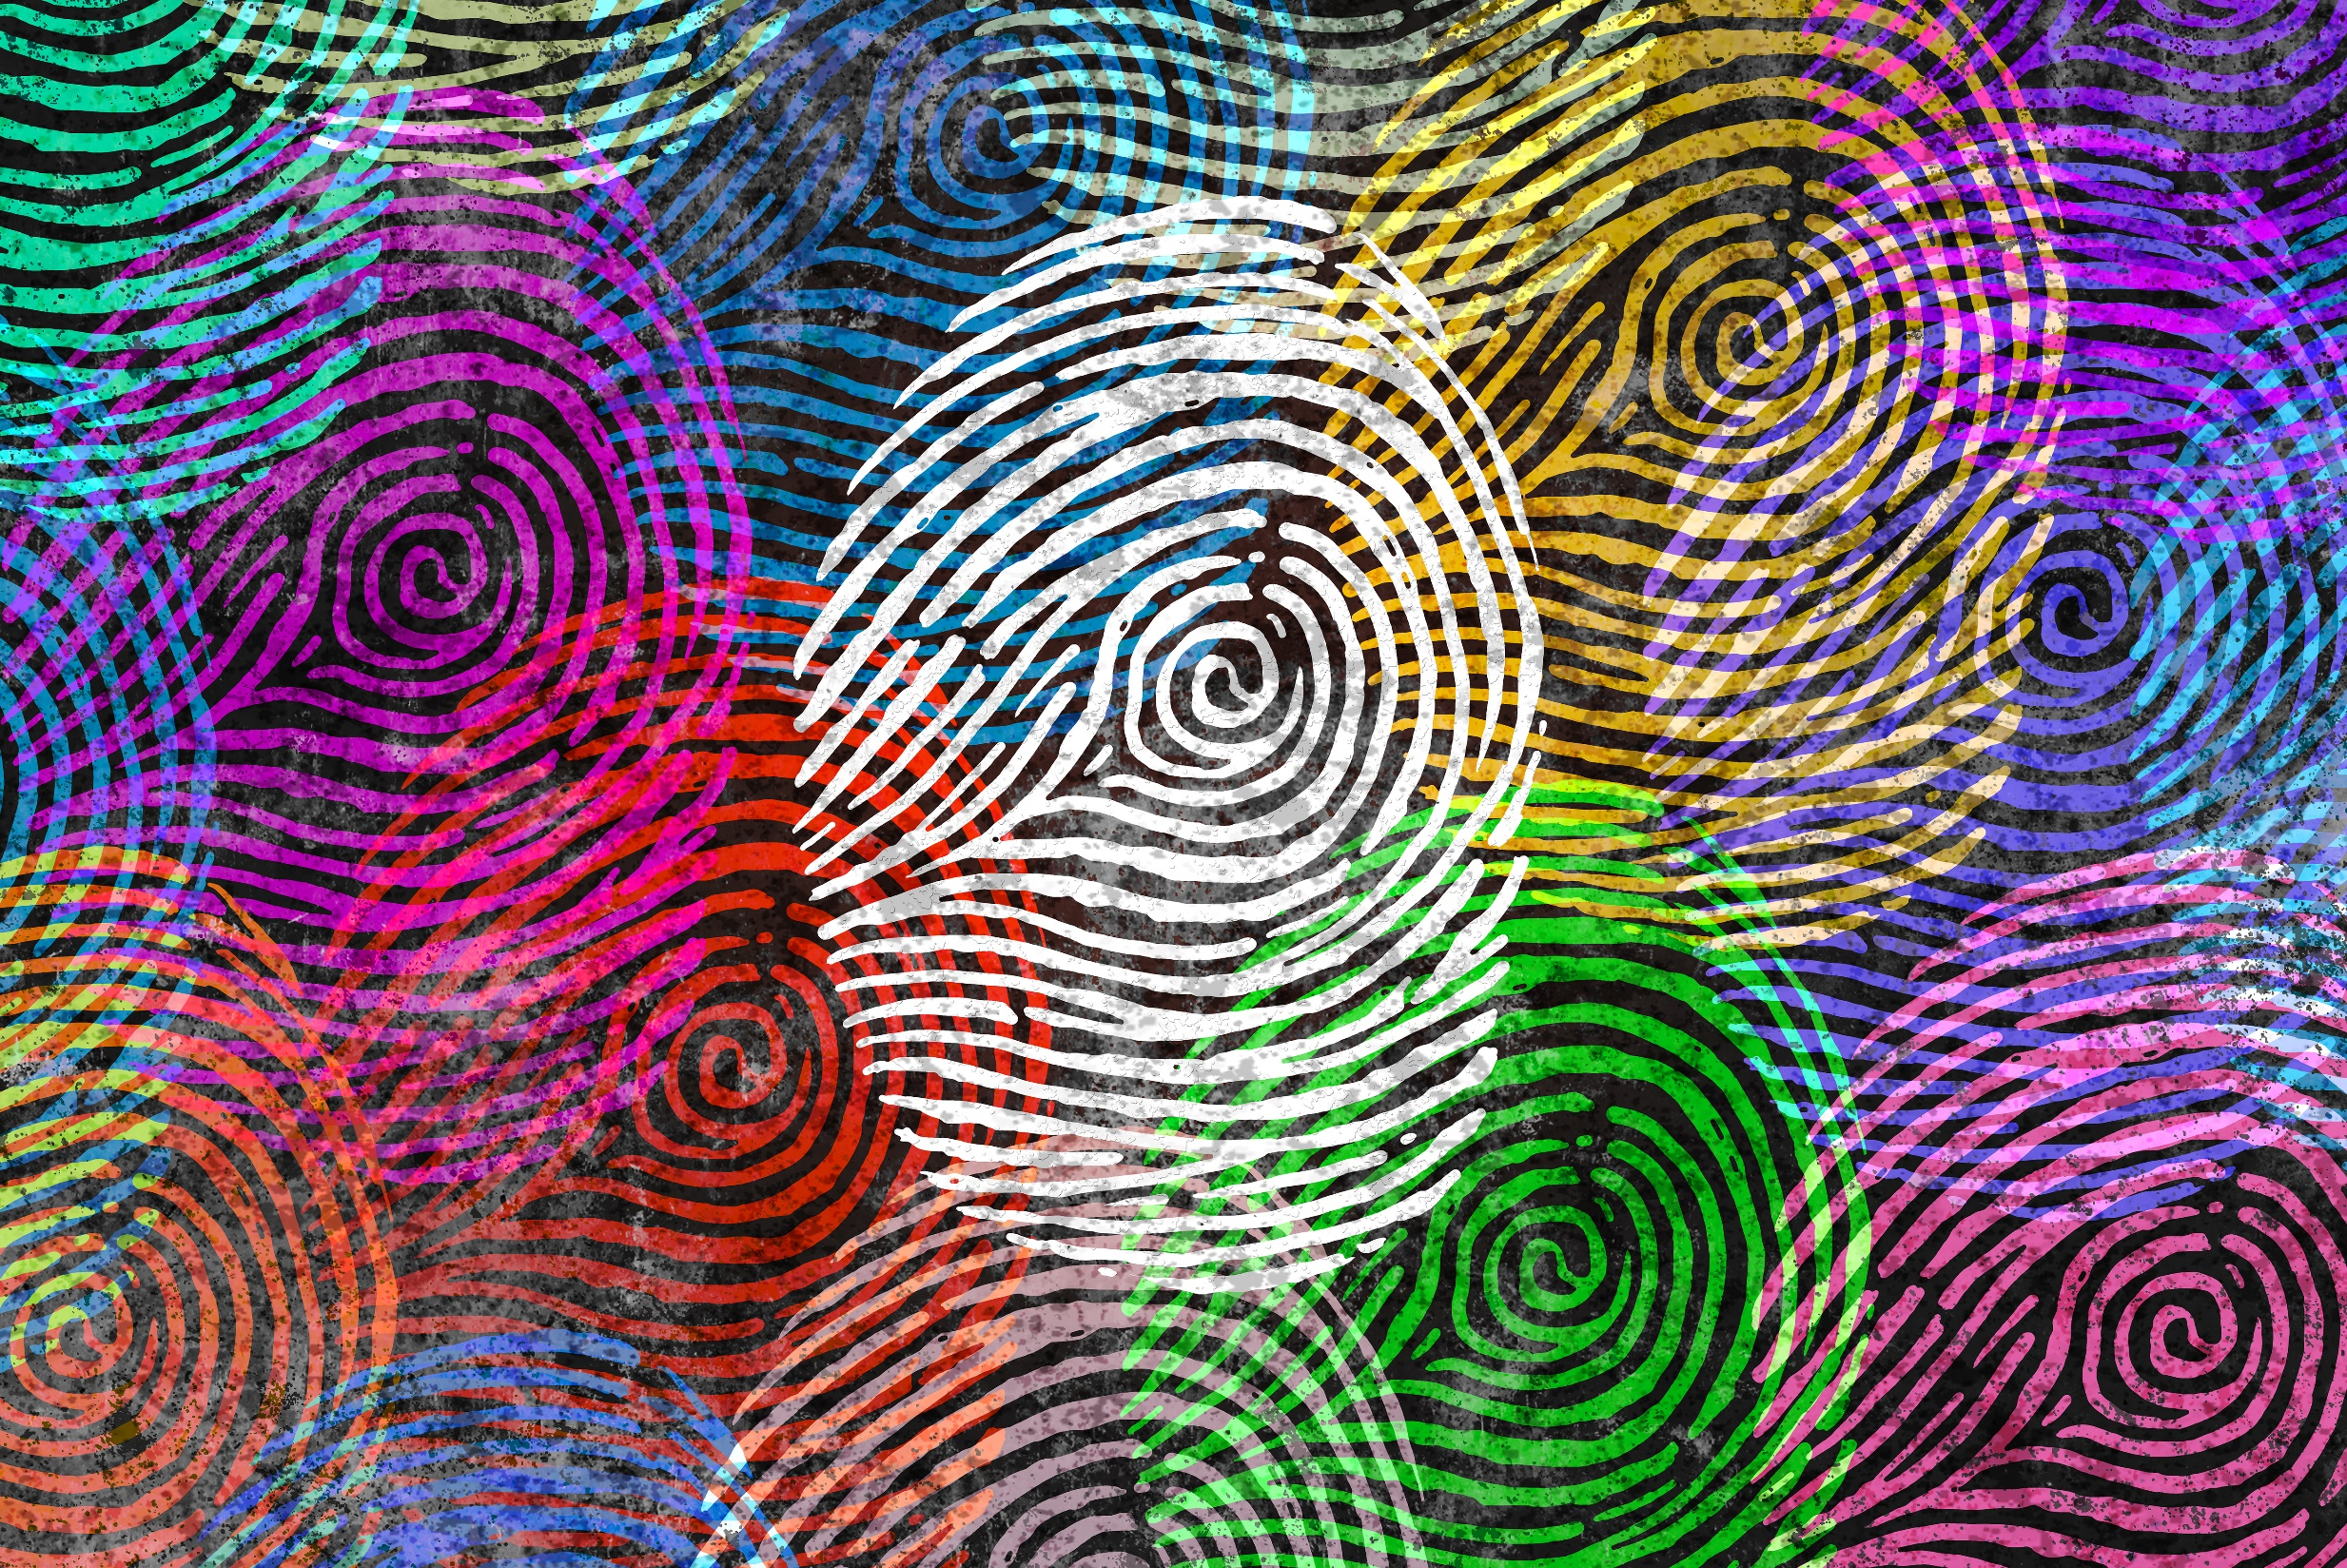
Lukas Wallrich (lukas.wallrich@ stmarys.ac.uk) October 2020 .
PSY4013 – Intro to Social Psychology
3: Group effects and social influence
A: Social facilitation & social loafing
Notes:
Lecture split into multiple parts, with small review questions in between – this first part is the heaviest

Slide 2
Do you work harder if you are alone or in the presence of others?
Do you work better if you are alone or in the presence of others?

Slide 3
Social facilitation – it depends
(Kotzer, 2007)
(Michaels et al., 1982)
Notes:
Experts benefited from audience – beginners didn’t

Slide 4
Social facilitation – mechanism
Drive theory (Zajonc, 1965)
Arousal strengthens dominant response (the one that comes more naturally)
Easy task … improvement
Difficult task … impairment
(Individual differences!)
Presence of others
Increases arousal
Dominant response
Improves performance
Impairs performance
Notes:
Baron & Branscombe (2013) Social psychology; Hogg & Vaughan (2014) Social psychology

Slide 5
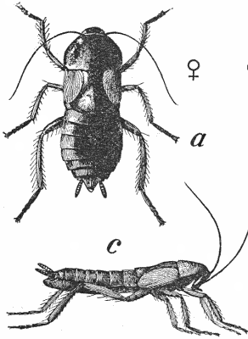
Atypical evidence for arousal
Zajonc et al. (1969) found that Blatta orientalis run a runway faster and a maze slower when they are in the presence of an audience than when they are alone.
Blatta orientalis – black beetles

Slide 6
Evaluation apprehension (Cottrell, 1972)
Not just the presence of others
Approval and disapproval based on evaluations by others
Presence of others causes arousal because of expectation that we will be evaluated / judged
Why does evaluation concern us? When?
Notes:
Baron & Branscombe (2013) Social psychology; Hogg & Vaughan (2014) Social psychology

Slide 7
What’s going on here? (Markus, 1978)

Slide 8
Combining the theories
Any audience affected performance of difficult task
Attentive audience affected performance of simple task
Drive theory. Arousal affects difficult task
Evaluation apprehension. Supports simple task

Slide 9
Thinking back to the selves
Self‐awareness theory (Carver & Scheier, 1981)
Presence of others directs attention to self
Comparisons between actual self and ideal self
Discrepancies create desire/pressure to align actual self with ideal self
Easy task… small discrepancies increase effort and performance
Difficult task… large discrepancies decrease effort and performance
Notes:
Baron & Branscombe (2013) Social psychology; Hogg & Vaughan (2014) Social psychology

Slide 10
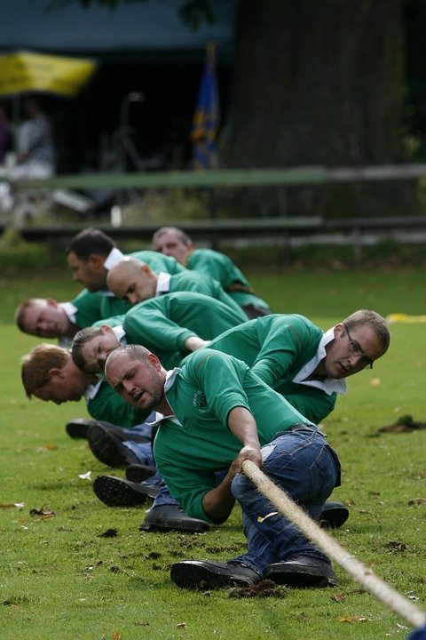
Social loafing – Ringelmann effect (1931)
Notes:
Baron & Branscombe (2013) Social psychology; Hogg & Vaughan (2014) Social psychology

Slide 11
Social loafing – Ringelmann effect (1931)
Force exerted per man decreased as number of men increased
Why?
Coordination
Motivation?
Notes:
Baron & Branscombe (2013) Social psychology; Hogg & Vaughan (2014) Social psychology

Slide 12
Social loafing <> free-rider effect (Frolich & Oppenheimer, 1970)
Free-riders take advantage of a public shared resource without contributing
Social loafers. Reduce effort but still contribute
Notes:
Baron & Branscombe (2013) Social psychology; Hogg & Vaughan (2014) Social psychology

Slide 13
Why loaf?
Fairness Don’t want to do more than our share and expect others to loaf
Lack of evaluation Can disappear in the crowd, if effort is unidentifiable
Matching to standard Unclear performance standard
Who loafs?
Men
People in individualistic cultures – less in collectivistic cultures
Notes:
Baron & Branscombe (2013) Social psychology; Hogg & Vaughan (2014) Social psychology
In general, stronger in men and stronger in individualistic rather than collectivistic cultures – so one of the areas where targeted research matters

Slide 14
Reducing social loafing
⬆ Personal identifiability. Makes it difficult to social loaf
⬆ Personal commitment & perceived task importance. Offsets the temptation to social loaf
⬆ Performance standard Introduction of clear targets, relative to others or to past performance
At the extreme: social compensation
Notes:
Baron & Branscombe (2013) Social psychology; Hogg & Vaughan (2014) Social psychology

Slide 15
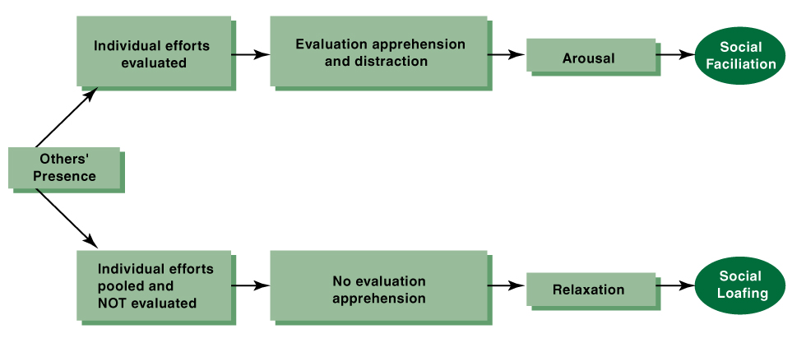
Loafing vs facilitation
(derived from Myers, 2002)

Slide 16
Lukas Wallrich (lukas.wallrich@ stmarys.ac.uk) October 2020 .
PSY4013 – Intro to Social Psychology
3: Group effects and social influence
B: Deindividuation & crowd behaviour
Notes:
Lecture split into multiple parts, with small review questions in between – this first part is the heaviest

Slide 17
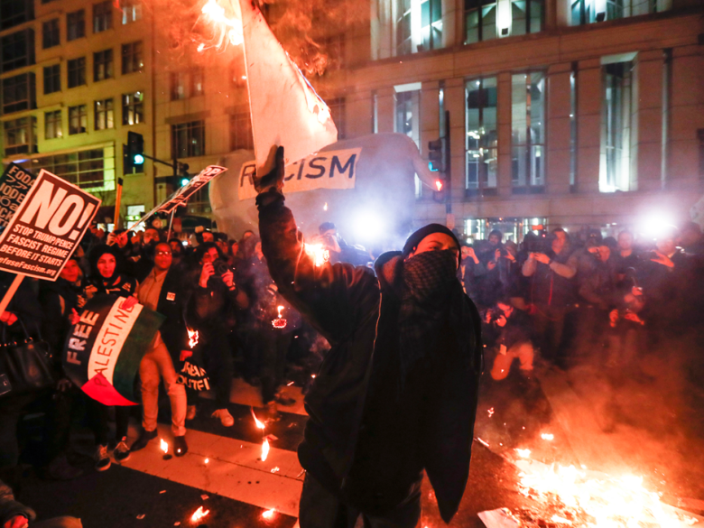
Group Processes
Deindividuation
Loss of self-awareness & evaluation apprehension leading to the loosening of normal constraints on behaviour when people are in a crowd, often leading to an increase in impulsive and deviant acts.
“Mob” behavior
Deindividuation
Notes:
Deindividuation Loss of self-awareness & evaluation apprehension
So more impulsive and deviant actions in a crowd that people would not support otherwise
(and, of course, anonymity allows people to do what they would always like to do)

Slide 18
Deindividuation
Traditional deindividuation theory: anonymity (e.g., in a crowd) promotes transgression
Social identity model of deindividuation effects: deindividuation can make group membership more salient, and thus increase influence of group norms
Postmes & Spears (1998) meta-analysis found better support for the latter

Slide 19
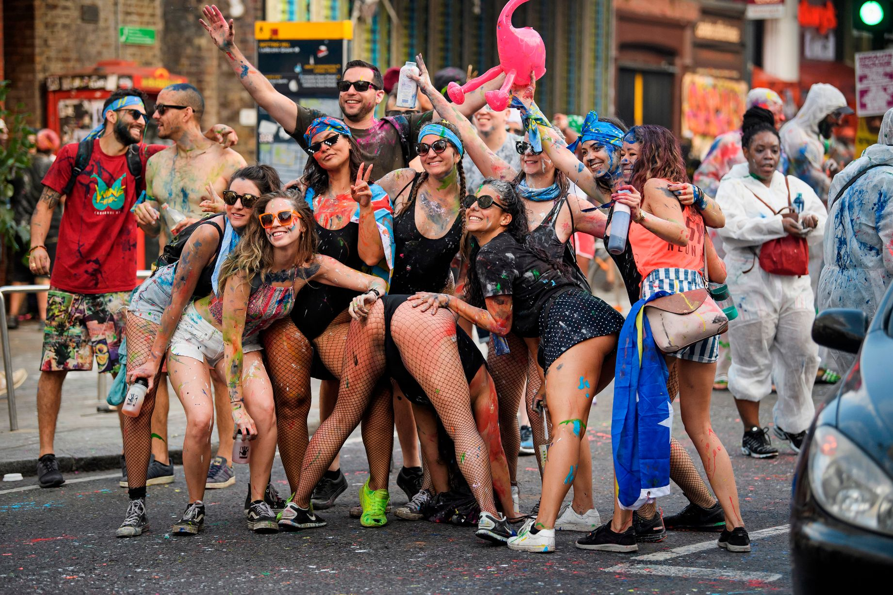
Impulsive and deviant acts can be fun
Notes:
Deindividuation Loss of self-awareness & evaluation apprehension
So more impulsive and deviant actions in a crowd that people would not support otherwise
(and, of course, anonymity allows people to do what they would always like to do)

Slide 20
Deindividuation
Loss of self-awareness & evaluation apprehension leading to the loosening of normal constraints on behaviour when people are in a crowd, often leading to an increase in impulsive and deviant acts.

Slide 21
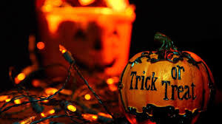
Impact of deindividuation (Diener et al., 1976)
Notes:
Children stealing money and sweets during trick or treat house call
Only one variable randomised! Alone or in groups did occur naturally

Slide 22
Impact of deindividuation (Diener et al., 1976)
(derived from Myers, 2002)
Notes:
Children stealing money and sweets during trick or treat house call
Only one variable randomised! Alone or in groups did occur naturally

Slide 23
Deindividuation
Two important factors:
Makes people feel less accountable for their actions
Increases obedience to group norms
However, not all impulsive behaviour is negative; it may result in pro-social behaviour depending on group norm(s).

Slide 24
Lukas Wallrich (lukas.wallrich@ stmarys.ac.uk) October 2020 .
PSY4013 – Intro to Social Psychology
3: Group effects and social influence
C: Opinion formation in groups
Notes:
Lecture split into multiple parts, with small review questions in between – this first part is the heaviest

Slide 25
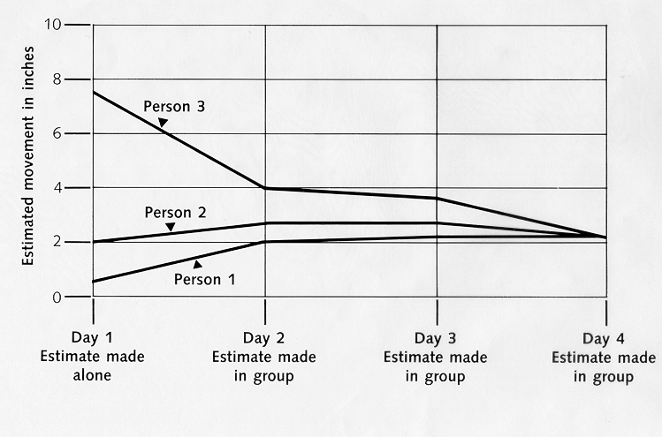
Group convergence
Data from Sherif & Sherif (1967)

Slide 26
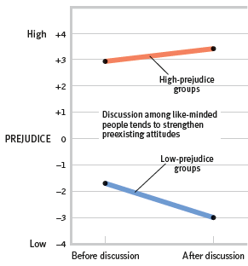
Group Polarisation
(Myers & Bishop, 1970)

Slide 27
Group Polarisation
...tendency for groups to make decisions that are more extreme than the initial inclinations of its members.
Why?
Persuasive arguments
Social learning / social comparisons
But also: social identity (Turner) – strive for cohesion and distinctiveness

Slide 28
Group Polarisation Echo chambers
Easy to have online-”conversations” with like-minded people
Debates: how new? How influential?

Slide 29
Safety first???
Notes:
1986: Space Shuttle Challenger exploded 73 seconds after start – all crew died. 17% of Americans watched live.
Problem a defective O-Ring … known as an annoyance before, therefore ignored by too many decision makers

Slide 30
Groupthink
Defective decision making when group cohesiveness is more important than considering the facts realistically
Janis (1971) proposed antecedents (i.e. conditions): high cohesion, high status, isolation, in crisis, with a directive leader
Symptoms: illusion of invulnerability, self-censorship, illusion of unanimity
Baron (2005): “So right it’s wrong” – ubiquity of groupthink – symptoms are so often found that it’s hard to detect special instances
Notes:
Link to Baron: https://pdfs.semanticscholar.org/bb27/fcd4fbdb5145993c70bb12b251457283cfa3.pdf
It would be better to read the book chapter that has gone through editing, but this is easier to access.

Slide 31
Avoiding groupthink
Leader should be impartial (speak last)
Outside opinions should be invited
Idea generation and evaluation be separated
Group should be divided into subgroups that discuss separately
Individuals should commit to initial opinion on their own – in writing (then cognitive dissonance can counteract groupthink)

Slide 32
Lukas Wallrich (lukas.wallrich@ stmarys.ac.uk) October 2020 .
PSY4013 – Intro to Social Psychology
3: Group effects and social influence
D: Conformity & compliance
Notes:
Lecture split into multiple parts, with small review questions in between – this first part is the heaviest

Slide 33
Asch’s Study (1955)
standard
comparisons
1
2
3
Notes:
12 critical trials
75% of participants conformed at least once
32% went along on average

Slide 34
Why?
Informational Influence
Accepting evidence about reality by other people.
Normative Influence
Desire to fulfil others’ expectations, often as a way of gaining acceptance.

Slide 35
Social Influence
Conformity: Deep-seated, private and enduring change in behaviour and attitudes due to group pressure.
Compliance: Publicly acting (behaviour & expressed attitude) in accord to social pressure while privately disagreeing.
Obedience: Carrying out orders given by a person invested with authority.

Slide 36
Conformity & compliance
Informational Influence
Accepting evidence about reality by other people.
Conformity
Normative Influence
Desire to fulfil others’ expectations, often as a way of gaining acceptance.
Compliance
Notes:
Ash interviewed subjects, most referred to normative influence
Harder version of the experiment, with higher rate of agreement with group’s answer – likely because information matters more
When the situation is ambiguous
When the situation is a crisis
When other people are experts

Slide 37
Conformity
Data from Sherif & Sherif (1967)

Slide 38
“Do as most do, and [people] will speak well of thee.”
Thomas Fuller
(as quoted in Aronson, Wilson, & Akert, 2002)
Notes:
English late medieval priest and writer

Slide 39
Conformity: When & Why?
Unanimity
Group Size
Cohesion
Status
No Prior Commitment
Public Response

Slide 40
Conformity & Unanimity
If someone punctures the group’s unanimity, it is enough to deflate its social power.
(Allen, 1975; Morris & Miller, 1975)

Slide 41
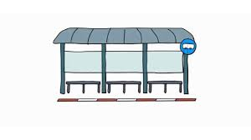
Conformity & group size
Mann (1977): needed 6 people to start a queue at a bus stop in Israel
Ash (1951): 3 confederates enough to reach maximum conformity on line experiment
but Gerard et al. (1968) found linear effect up to 7 participants
standard
comparisons
1
2
3

Slide 42
Conformity: When & Why?
Status
Higher-status members have more impact
Cohesion: The more cohesive a group, the more control/power it gains over its members
Minority opinion from within the group has more impact than minority influence from outside the group.
See Moscovici’s (1980, 1985) Conversion Theory

Slide 43
Conformity: When & Why?
Public Response
If we can voice dissension in private, we might be less likely to conform (even though Bond, 2005, does not find this in a meta-analysis of Ash-type experiments)
No Prior Commitment
Making a (public) commitment makes it more likely that someone will not change their mind
No need to be correct
Pay-off comes from being liked, rather than being right

Slide 44
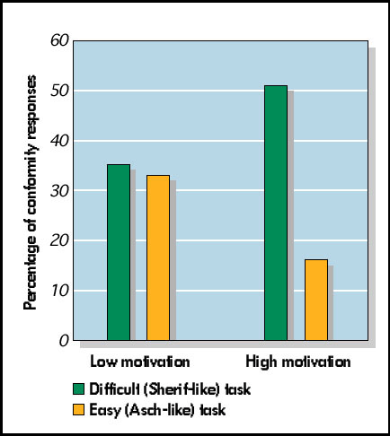
Conformity & motivation (Baron et al., 1996)
Notes:
Baron, Vandello, & Brunsman (1996): asked groups of students to choose a criminal suspect from a line-up.
Some saw the pictures so quickly it was hard to be certain about their judgments. Others had ample time.
In addition, some students were motivated to be accurate with the promise of a $20 prize; others had no incentive (were not motivated to be accurate).

Slide 45
Normative Influence
As humans we tend to be social creatures and thus have a need for companionship
Conformity in order to be liked and accepted by others.
(See Asch, 1951; Deutsch & Gerard, 1955, Nail, 1986)
If a person resists normative influence other members will try and convince the “deviant” member to conform.
If he or she does not, eventually the deviant could be rejected (even though there is some idiosyncrasy credit)
Can “group norms” be collectively misunderstood?

Slide 46
Minority Influence
Moscovici (1985): A minority can cause change in the majority.
(Need: consistency over time and consistent unanimity among members of the minority.)
Wood et al. (1994):
Majorities often cause public compliance because of normative influence.
Minorities often cause private acceptance because of informational influence.

Slide 47
Some take-aways
Social facilitation better performance on simple and worse performance on difficult tasks in the presence of others (arousal? evaluation apprehension?)
Social loafing people reduce their effort in groups, esp. when results are pooled and effort is not observed.
Deindividuation group members following group rather than personal norms; can be “mob mentality”
Groups tend to develop more coherent and polarised opinions over time.
Groups shape individual judgements through informational and normative influences – first leads to conformity, latter to compliance
Groups often struggle to make good decisions due to conformity, confirmation bias etc. Persistent minority members can change group opinions and decisions.

Slide 48
Lukas Wallrich (lukas.wallrich@ stmarys.ac.uk) October 2020 .
PSY4013 – Intro to Social Psychology
3: Group effects and social influence
Bonus: Some thoughts on Milgram, obedience and conformity
Notes:
Lecture split into multiple parts, with small review questions in between – this first part is the heaviest

Slide 49
Milgram and social influence

Slide 50
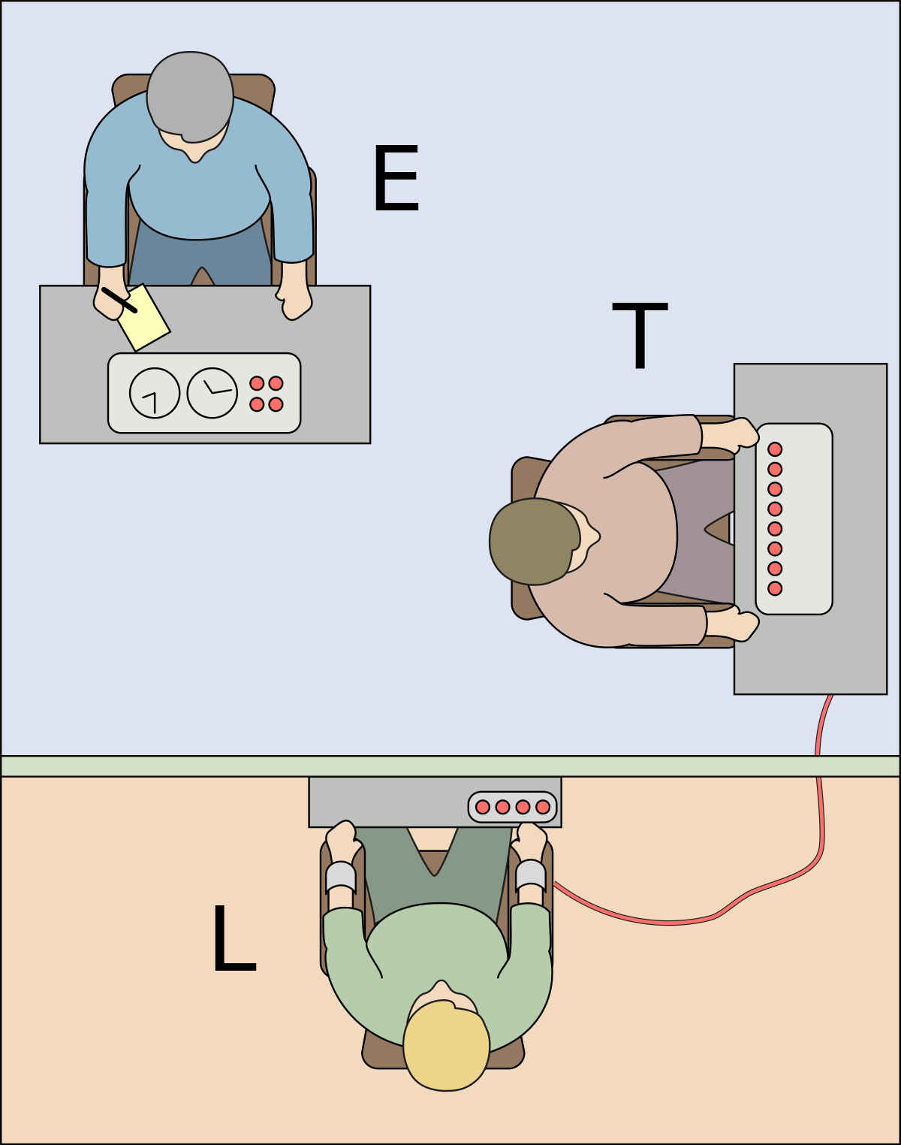
The “baseline” condition

Slide 51
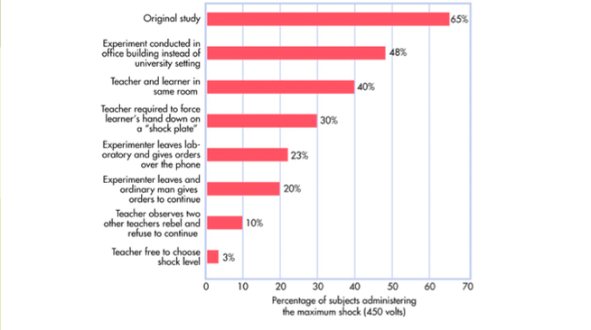
Some variations

Slide 52
Obedience or conformity?
Prompts by experimenter:
Please continue.
The experiment requires that you continue.
It is absolutely essential that you continue.
You have no other choice; you must go on.
In replication, no one obeyed last prompt (Burger et al., 2011)
Haslam et al. (2014): discovered “engaged followership” in original transcripts

